Slide 1

DATA ANALYTICS PROJECT

Slide 2

Task 1
Introduction
Data Cleaning
Discovery Data
Insights
Categories Performance
Promotional Effectiveness
Category Cluster
Waste Management
Take Away
04
05
06
07
12
15
16
19
Task 2
Introduction
Data Cleaning
Discovery Data
Descriptive Analysis
Seasonality & Forecast
Clusters
21
22
23
24
28
32

Slide 3
Task 1
Insights and recommendations

Slide 4

Introduction
I created a business case to provide the Commercial and Supply Chain teams with key insights. In this presentation, I'll walk you through the discoveries, steps, and major decisions made to achieve the best outcome. Let's dive into the details and set the stage for informed actions.

Slide 5
Data Cleaning
For the Data Cleaning step, here the steps that I follow:
Categories level data have emotions. Removed all emotions using RE;
Create the Date Columns: Year, Week, Year-Week;
Some rows have Unique SKUs Sold > Unique SKUs Listed, which can be understood as mistake. Corrected the data in Unique SKUs Listed for: When Unique SKUs Sold > Unique SKUs Listed then Unique SKUs Sold ;
Remove data when Year-Week = '2023-26' due lack of data (Week was incomplete) ;
Create new columns for support decisions.

Slide 6
Discovery Data
During the data exploration phase, I delved into the dataset to gain a comprehensive understanding of its underlying behaviors. Here are the key findings from this exploration:
Total Dataset Period: The dataset spans a duration of 3 months.
Negative Discounts: Noteworthy is the presence of negative discounts in the database. This could suggest a potential increase in prices within the category utilizing the Promotional Price Field.
Main Categories at Level 0: The primary categories at Level 0 include Fresh Food, Grocery Food, and Grocery Non-Food. Other entries primarily pertain to packaging, and "Not Defined" is deemed non-relevant in the context of this analysis.

Slide 7
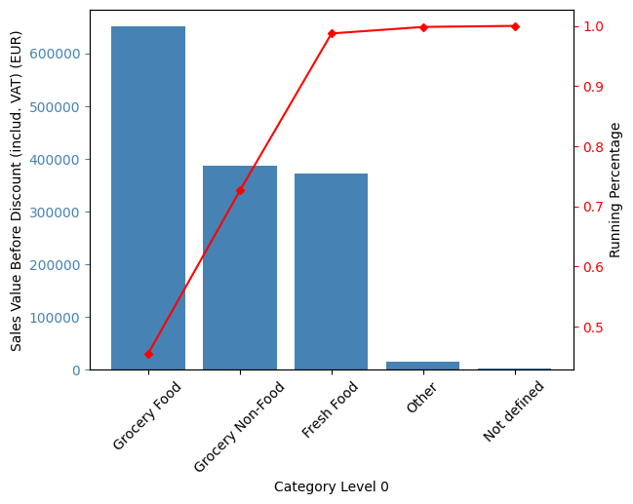
Insights
Categories Performance
Grocery Food, Grocery Non-Food, and Fresh Food collectively contribute to an impressive 98.74% of the Total Sales Value Before Discount. Given this substantial influence, it is recommended that the company's goals and strategies be concentrated on these pivotal categories. Notably, Grocery Food stands out as the most significant contributor, representing 45.57% of the total sales value before discount. Prioritizing efforts and initiatives within these key categories aligns with maximizing overall business impact and financial outcomes.

Slide 8
Insights
Categories Performance
Category level 0-1 | Total Sales Value Before Discount EUR
Grocery Non-Food|Tobacco & Heated Tobacco | €284,075
Grocery Food|Beverages | €97,569
Grocery Food|Water & Flavoured Water | €90,122
Fresh Food|Fruits & Vegetables | €86,791
Fresh Food|Dairy & Eggs | €82,959
Grocery Food|Ice Cream | €82,592
Fresh Food|Meat & Fish | €71,208
Grocery Food|Wine | €69,697
Grocery Food|Beer & Cider | €64,910
Grocery Food|Salty Snacks | €56,236
The Top 10 Category Level 1 includes certain categories that might be ranking high due to their seasonality, particularly in the summer.
To validate this hypothesis, it is imperative to gather additional data to discern whether these categories exhibit exceptional performance primarily during the summer season.
TOP 10 Category Level 1

Slide 9
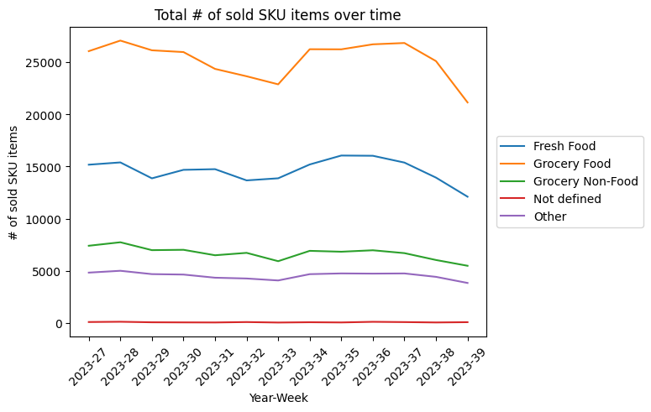
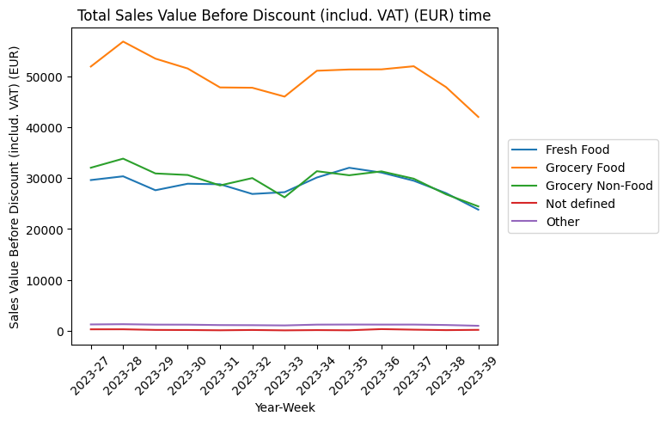
Insights
Categories Performance
The performance of the # of Sold SKU remains relatively constant over time. Notably, Grocery Non-Food and Fresh Food consistently vie for the second position when analysing Sales Value. This intriguing observation can be attributed to the fact that, although Fresh Food outpaces Grocery Non-Food in terms of sales volume, the higher Price per Product in Grocery Non-Food makes it a formidable contender for the second position.

Slide 10
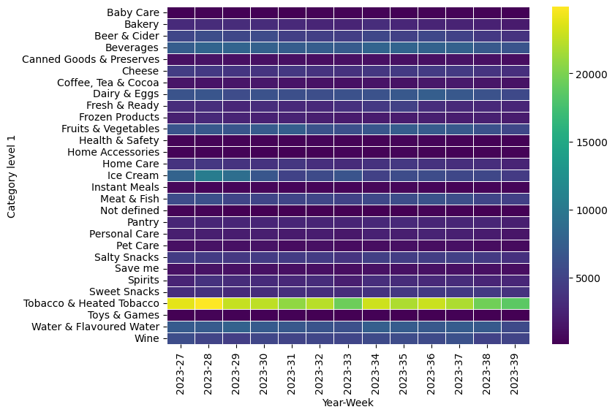
Insights
Categories Performance
Transitioning to Category Level 1, it becomes evident that the category exhibiting the highest performance in terms of Sales Value is Tobacco & Heated Tobacco.

Slide 11
Insights
Categories Performance
The "Other" category emerges as the one with the highest discount, likely attributed to its role primarily in packaging. The incentive to collaborate on costs may explain this inclination towards discounts.
Subsequently, the "Not Defined" category tends to offer higher discounts, possibly aimed at reducing stock levels for less critical products.
Contrastingly, the "Grocery Non-Food" category shows a lower tendency to offer discounts. This may be indicative of the category's inelastic nature, suggesting that consumer demand for these products is less responsive to price changes.
Category level 0 | Discount Perc | Price per SKU Before Discount (includ. VAT) (EUR) | Price per SKU After Discount (includ. VAT) (EUR)
Grocery Non-Food | 1.12% | €4.43 | €4.38
Not defined | 8.01% | €2.72 | €2.50
Grocery Food | 5.46% | €1.98 | €1.87
Fresh Food | 7.09% | €1.96 | €1.82
Other | 50.44% | €0.26 | €0.13

Slide 12
Insights
Promotional Effectiveness
I conducted a regression analysis to explore the impact of Total Discount on Total Profit—a crucial metric we seek to optimize. The analysis focused initially on Fresh Food and Grocery Food categories, both characterized by substantial discount levels.
In this analysis:
Dependent Variable: Total Profit
Independent Variables: Total Discount
By employing regression analysis, we aim to discern the quantitative relationship between the independent variables (Total Discount) and the dependent variable (Total Profit). This approach enables a nuanced understanding of how promotional activities, influence overall profitability, particularly within the Fresh Food and Grocery Food categories. Further insights from this analysis can guide strategic decisions aimed at optimizing promotional efforts and maximizing profits.

Slide 13
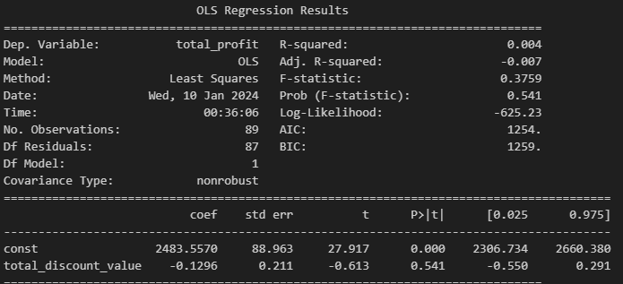
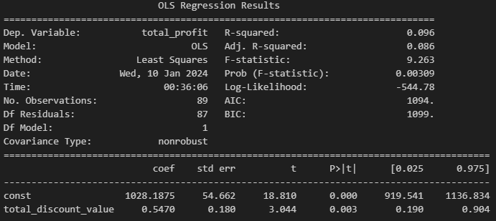
Insights
Promotional Effectiveness
In the context of Grocery Foods, the regression analysis reveals a negative coefficient for Total Discount Value, accompanied by a p-value greater than 0.05. This implies that, from a statistical standpoint, there isn't sufficient evidence to confirm that Total Discount significantly affects Total Profit in the Grocery Foods category.
It's important to interpret these findings cautiously and consider additional factors that may influence the observed relationship. Further exploration and analysis may be necessary to uncover nuanced insights into the dynamics between discounting strategies and profitability within the Grocery Foods category.
In the case of Fresh Foods, the regression analysis indicates a positive coefficient for Total Discount Value, accompanied by a p-value less than 0.05. This signifies that, with a 95% confidence level, we can confirm that offering discounts in the Fresh Foods category is a statistically valid strategy to enhance profit. Specifically, for every 1 EUR in discount, the profit is estimated to increase by 0.54 EUR.

Slide 14
Insights
Promotional Effectiveness
Subsequently, I extended the analysis to encompass all Level 1 categories within Grocery Food and Fresh Food. Here are a few instances where employing discounts proves to be an effective strategy for profit enhancement.
Category Level 1 | Coef.
Fresh Food|Cheese | 0.5955
Fresh Food|Dairy & Eggs | 0.4904
Fresh Food|Fresh & Ready | 1.0527
Fresh Food|Fruits & Vegetables | 1.0018
Grocery Food|Beer & Cider | 1.3401
Grocery Food|Beverages | 0.7218
In conclusion, while the overarching trend in Grocery Food does not universally support the effectiveness of discounts, certain Level 1 categories within Grocery Food exhibit favorable performance with this strategy.
Moving forward, to validate and solidify these findings, I propose implementing A/B testing. This approach will provide a more rigorous and controlled experimentation to ascertain the validity of the coefficients observed in the regression analysis.

Slide 15
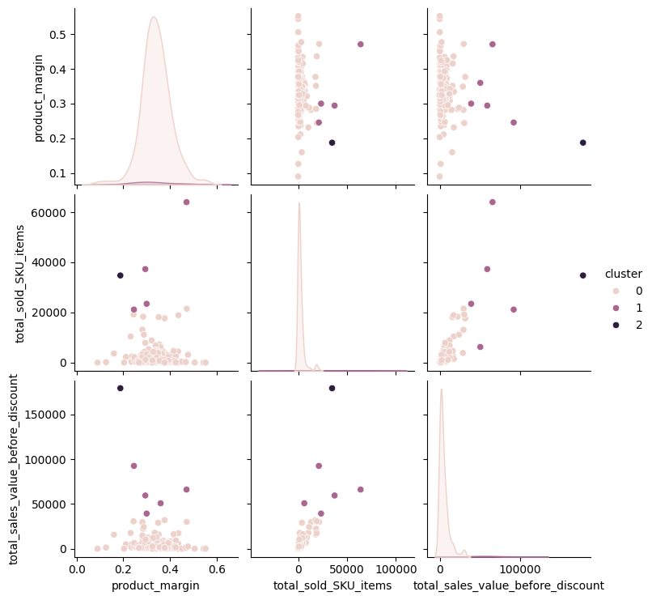
Insights
Cluster
Cluster analysis proves effective for categorizing similar Level 1 categories and devising specific strategies for each. I applied K-means classification, considering Product Margin, Total Sold SKU, and Total Sales Value for clustering. The elbow method determined the optimal number of clusters as n=3.
185 Categories have a similar behavior. Although, there 6 Categories that need more attention:
Fresh Food|Fruits & Vegetables|Fruits
Grocery Food|Beverages|Soft Drinks
Grocery Food|Ice Cream|Large
Grocery Food|Water & Flavoured Water|Still Water
Grocery Non-Food|Tobacco & Heated Tobacco|Heated Tobacco
Grocery Non-Food|Tobacco & Heated Tobacco|Cigarettes & Cigars
Except for Tobacco & Heated Tobacco, other categories seem to perform well, possibly due to the summer season. This observation aligns with the dataset's timeframe, spanning from July to September.
To confirm this hypothesis, a more extended period of data is required to validate whether these categories consistently excel only during the summer.

Slide 16
Insights
Waste Management
Waste management is vital to prevent product losses from expiration. Among categories, Fresh Food has the highest occurrence in total waste.
Category level 0 | Total Waste
Fresh Food | 16699
Grocery Food | 3264
Grocery Non-Food | 307
Not defined | 41
Other | 0
My suggestion for addressing this issue is to examine waste for underperforming categories and consider discontinuing the purchase of those products. In the next slide, I'll illustrate the problem.

Slide 17
Insights
Waste Management
I introduced a metric termed "Assortment Performance," which gauges the sales variety by assessing if at least one unit of each product is sold. The formula is as follows:
Assortment Performance = Unique SKUs Sold / Unique SKUs Listed
For this study, I assumed equal waste for all products, signifying that products expire uniformly.
I then calculated the Total Waste for Non-Performance using the formula:
Total Waste for Non Performance = Total Waste*(1-Assortment Performance)
Finally, I computed the Potential Saving to quantify the potential cost reduction by ceasing the purchase of non-performing products:
Potencial Saving = Unit Item COGS * Total Waste for Non Performance
These calculations help shed light on the potential financial benefits of optimizing the product assortment based on performance metrics.

Slide 18
Insights
Waste Management
Category level 0 | Potential Savings in Three Months
Fresh Food | €4,942
Grocery Food | €2,617
Grocery Non-Food | €433
Not defined | €61
Other | €0
Total | €8,054
In summary, there's a potential savings of €8,054 every three months by discontinuing the purchase of non-performing products. This is an initial estimate, and for a more comprehensive study, we would require a complete dataset spanning the entire year at the SKU level. This detailed data would enable us to precisely determine the potential savings and identify specific SKUs that should be considered for discontinuation.

Slide 19
Insights
Take Away
Grocery Food emerges as the primary Category Level 0, contributing 45.57% to the Total Sales Value.
Across all Level 0 categories, Sales Value and Total SKUs Sold exhibit a consistent pattern over time.
Grocery Non-Food stands out with the highest Ticket per SKU. Increasing Total Sold SKUs in this category could significantly boost overall Sales Value.
Tabacco & Heated Tobacco demonstrates outstanding performance.
The efficacy of discounts varies across categories, with some not positively impacting Profit.
Certain Level 1 categories, especially in the summer, exhibit distinct performance patterns, warranting tailored handling.
Implementing effective Waste Management, particularly by discontinuing non-performing products, has the potential to save approximately €8,054 in three months.

Slide 20
Task 2
Insights and recommendations

Slide 21
Introduction
In this business case, my objective was to deliver insights on seasonality, forecasting, and valuable strategic considerations. I will guide you through the key discoveries, steps taken, and significant decisions made to ensure the most optimal outcome.

Slide 22
Data Cleaning
For the Data Cleaning step, here the steps that I follow:
Cuisine column have emotions. Removed all emotions using RE;
Create the Date Columns: Year, Week, Year-Week and Weekday;

Slide 23
Discovery Data
The dataset provides a comprehensive overview of orders from two countries, Portugal and Ghana. Each row in the dataset represents an individual order, and the Total Order is determined by counting the rows.
Here are some key details about the dataset:
Geographical Scope: Portugal: City of Lisbon | Ghana: City of Accra
Restaurant Distribution: Ghana: 100 restaurants | Lisbon: 757 restaurants
Cuisine Variety: There are 72 different cuisines represented in the dataset.
Platform Information: Orders are placed through both IOS and Android platforms.
Payment Options: Payment methods include both Cash and Cashless transactions.

Slide 24
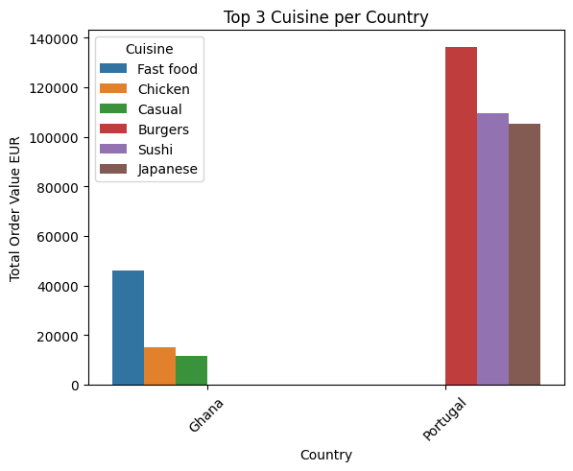
Insights
Descriptive Analysis
Country | City | Total Orders | Total Products Ordered | Total Order Value (EUR9 | AVG Product Per Order | AVG Ticket per Order
Ghana | Accra | 14132 | 40453 | €121,826.92 | 2.86 | 8.62
Portugal | Lisbon | 85486 | 207884 | €1,183,690.54 | 2.43 | 13.85
Bolt's presence in Portugal significantly outweighs its presence in Ghana, with a presence that is 10 times greater.
Moreover, the top three cuisines most frequently ordered in each country differ. In Portugal, the preferences lean towards Burgers, Sushi, and Japanese cuisine. Conversely, in Ghana, Fast Food, Chicken, and Casual dining take the lead.
Considering these distinct culinary preferences, prominently featuring these top cuisines on the main page could potentially drive more orders. Tailoring the main page to reflect the specific delivery preferences of each country enhances the user experience and increases the likelihood of attracting orders aligned with local tastes.

Slide 25
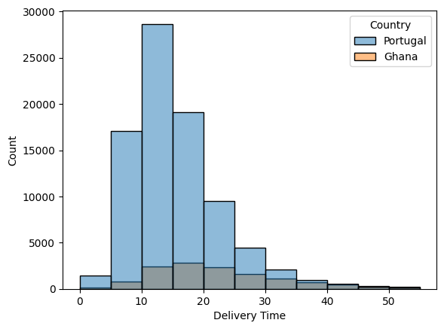
Insights
Descriptive Analysis
Examining the Delivery Time in both countries, Portugal demonstrates a relatively swift delivery range of 5-20 minutes per order. On the other hand, in Ghana, the delivery time is slightly longer, varying between 10-30 minutes.
To gain a comprehensive understanding of the factors contributing to these differences, acquiring additional data is recommended. This will facilitate a more nuanced analysis, allowing for insights into the underlying reasons for the variation in delivery times between the two countries.

Slide 26
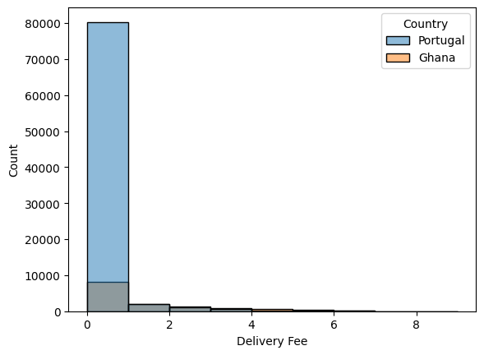
Insights
Descriptive Analysis
There is a substantial difference in the Delivery Fee between Portugal and Ghana, with Portugal experiencing notably higher fees. In Portugal, the Free Delivery Percentage is impressively high at 89%, while in Ghana, it is comparatively lower at 51%.

Slide 27
Insights
Descriptive Analysis
Both countries exhibit a commendable Fulfillment Rate, surpassing the 90% mark.
Country | City | Total Delivered | Total Failed | Total Rejected | Fulfilment Rate
Ghana | Accra | 13351 | 432 | 349 | 94.47%
Portugal | Lisbon | 84585 | 273 | 628 | 98.94%
In Portugal, the Fulfillment Rate stands impressively high at 98.94%, while in Ghana, it remains robust at 94.47%.
Cancel Reason | ReasonsCount
The restaurant rejected the order | 977 | 58.09%
Could not find a courier to deliver the order | 352 | 20.93%
The restaurant asked customer support to fail the order | 301 | 17.90%
User cancellation | 52 | 3.09%
The primary reason for a decrease in the Fulfillment Rate is the rejection of orders by the restaurant. To improve this metric, I recommend delving deeper into the specific reasons behind these cancellations. Understanding the root causes will enable the implementation of targeted solutions to address and mitigate the issues, ultimately enhancing the overall Fulfillment Rate.

Slide 28
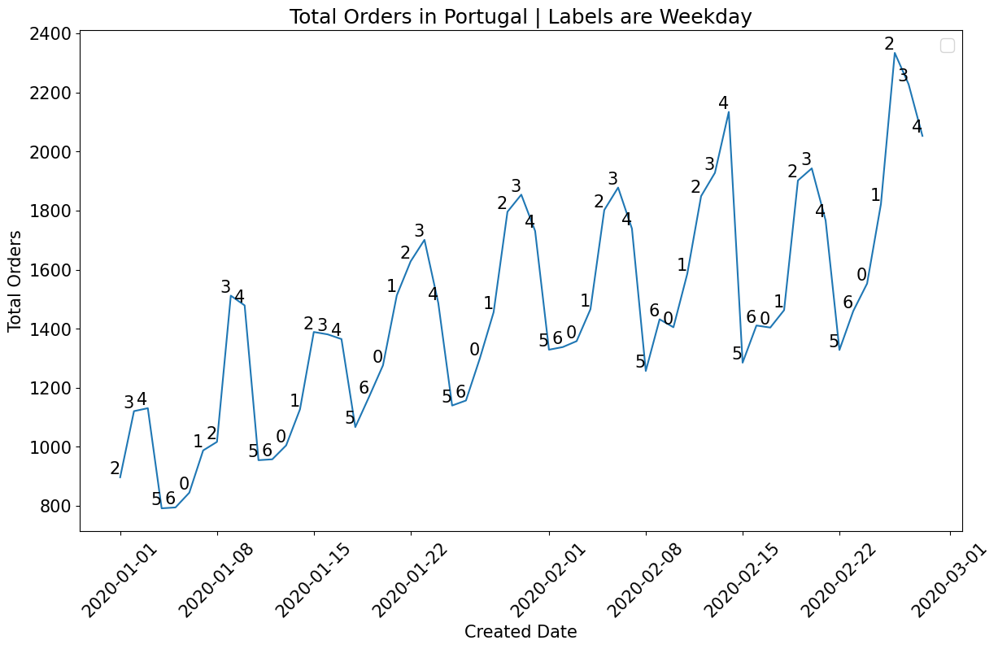
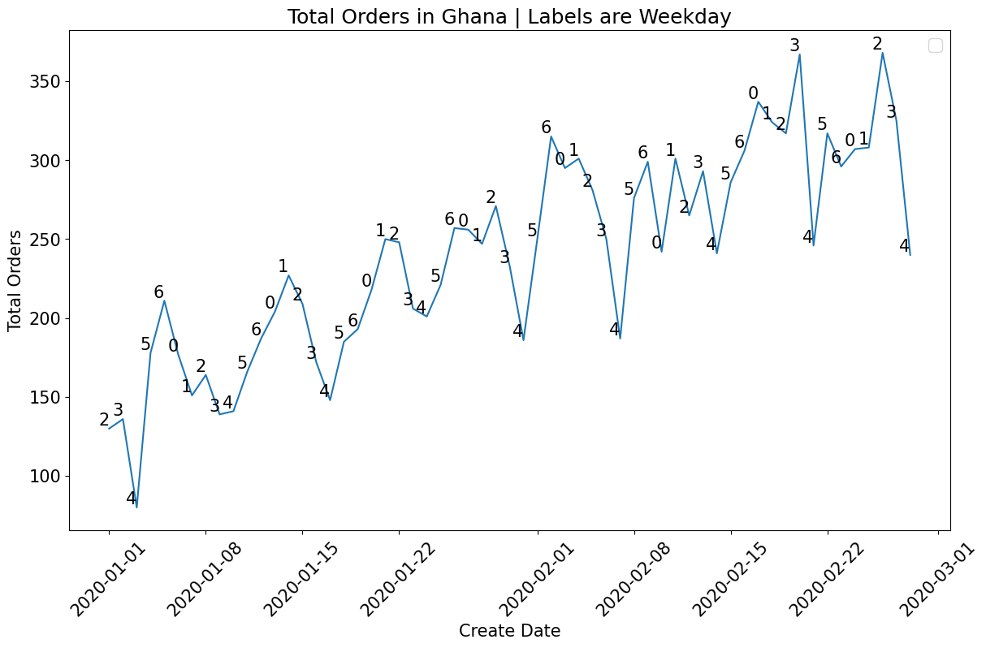
Insights
Seasonality & Forecast
Commencing with the Seasonality Analysis, the visual inspection of the above graphs clearly reveals the presence of seasonality in both Portugal and Ghana.
In Portugal, the peak of sales consistently materializes on Thursdays and Fridays.
Conversely, in Ghana, the peak sales predominantly occur on Sundays and Mondays. However, it's worth noting that the time series for Ghana exhibits considerable noise.

Slide 29
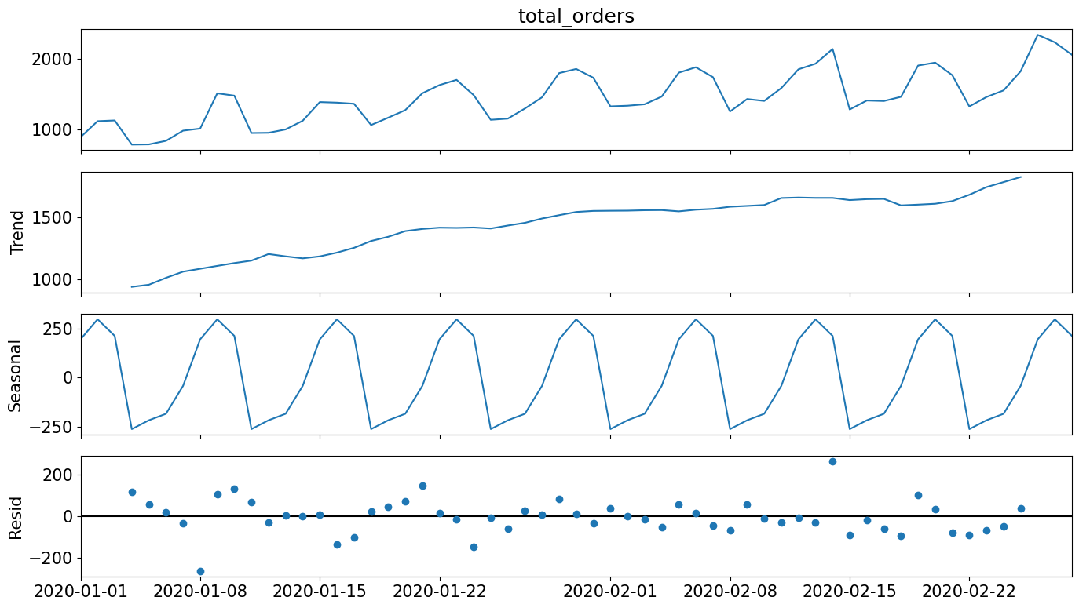
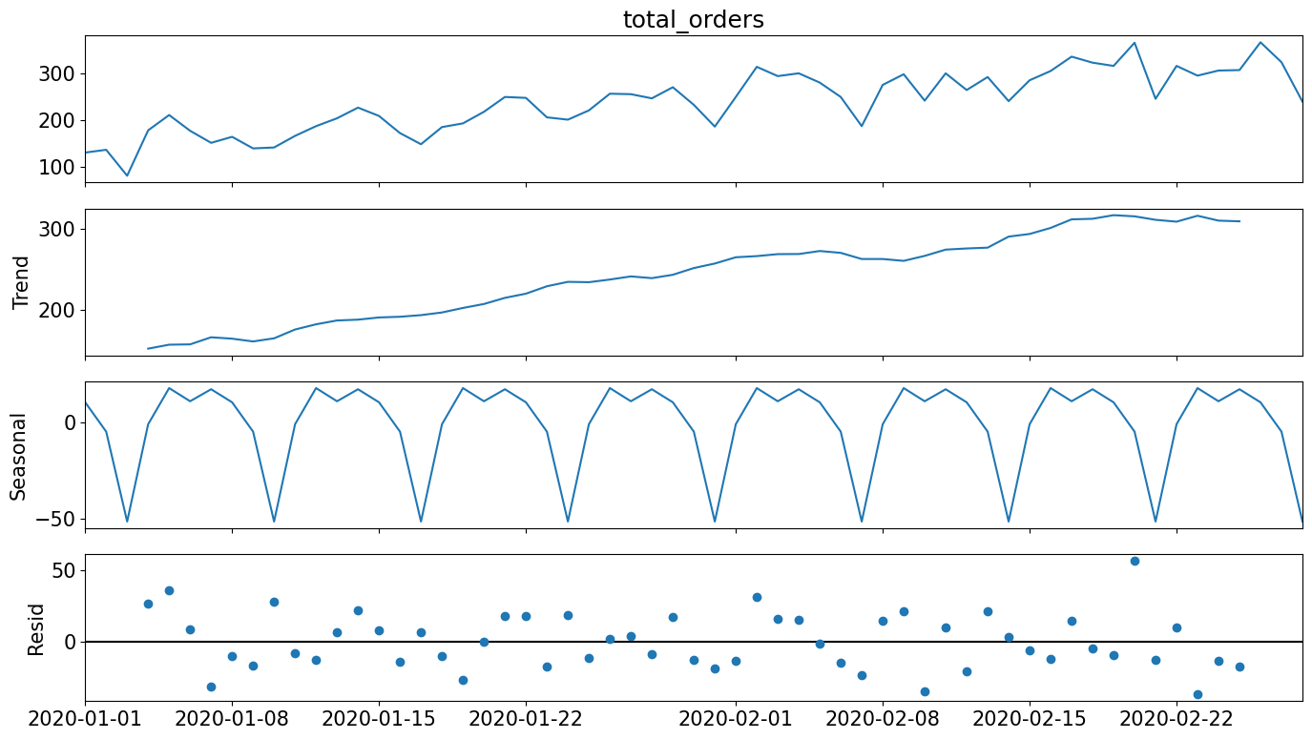
Insights
Seasonality & Forecast
Portugal Seasonal Decompose Graph
Ghana Seasonal Decompose Graph
To certificate that Portugal and Ghana have seasonality, I apply a Seasonal Decompose in the Timeseries.
Looking the Seasonal part in both graph, it is possible to confirm that there are Seasonality in Portugal and Ghana, both of 7 days.

Slide 30
Insights
Seasonality & Forecast
After establishing the presence of seasonality, let's delve into the forecasting phase.
Given the limited information available on the variable, I opted to employ the SARIMA model (Seasonal Autoregressive Integrated Moving Average) for the forecasting task.
Following the application of this methodology, I have derived individualized models for each country, demonstrating a strong fitting performance for accurate forecasts.

Slide 31
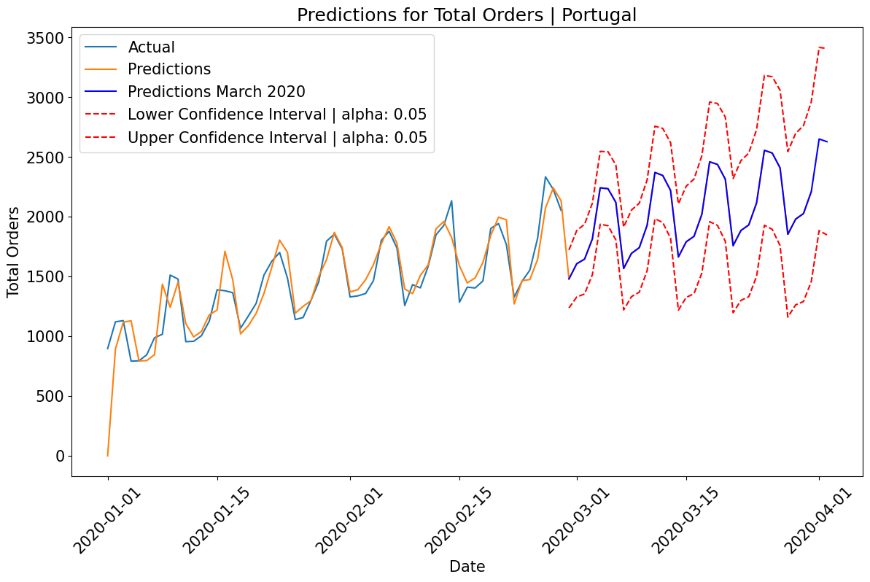
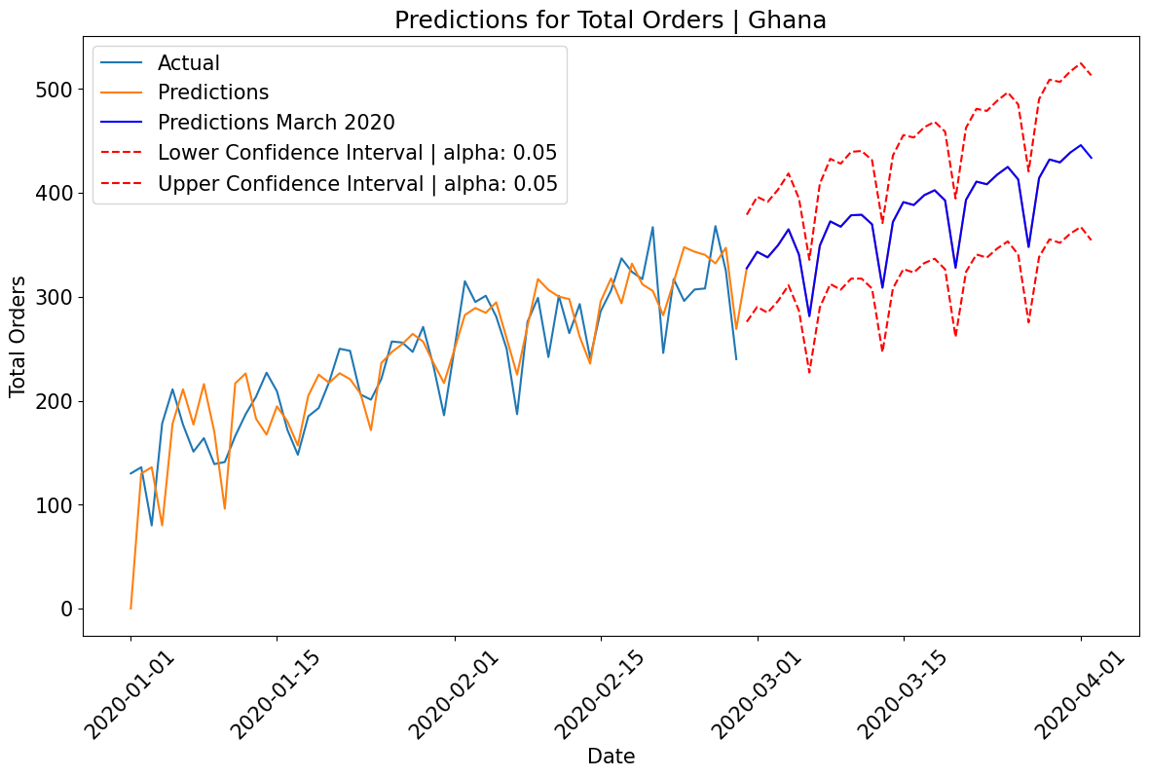
Insights
Seasonality & Forecast
With a confidence level of 95%, the projected range for Total Orders in March 2020 for Portugal is estimated to fall between 48,290 and 78,326 (Red Line).
The projected central value for Portugal is predicted to be 63,308 (Blue Line).
With a confidence level of 95%, the anticipated range for Total Orders in March 2020 for Ghana is estimated to fall between 9,735 and 13,758 (Red Line).
The projected central value for Ghana is predicted to be 11,746 (Blue Line).

Slide 32
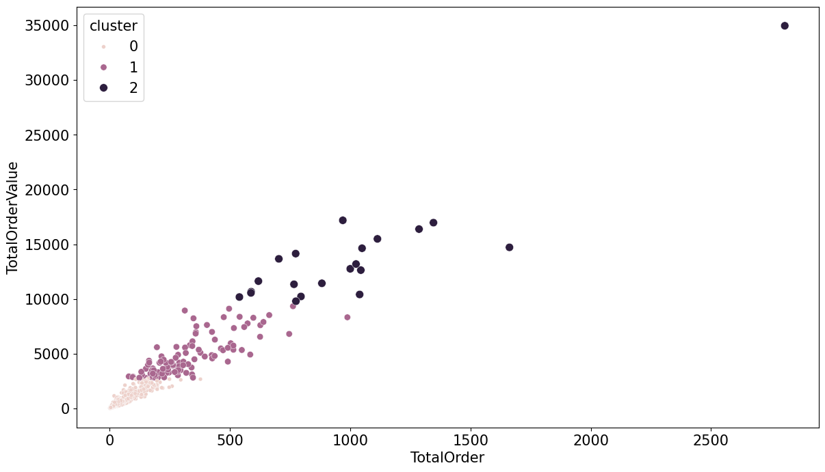
Insights
Cluster
In Cluster 2, comprising 23 restaurants, they play a significant role in driving Total Order Values. As such, encouraging their presence on the front page and implementing special deals could be beneficial.
Cluster 1, with 107 restaurants, may not currently be in the top tier, but they show potential for growth. Granting them additional importance is advisable, given their capacity to ascend to the top tier list.
Cluster 0 encompasses 625 restaurants, representing others that, while not of utmost importance, still contribute to revenue.

